Slide 1


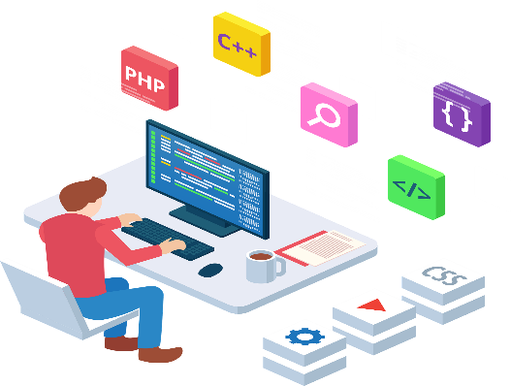
Web Fundamentals Project
How does the web work?
What do we need to be a web developer?
Why did I choose to learn web development?
In this project we will see:
Presented by Lina Bachtobji

Slide 2
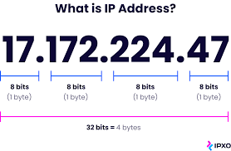


How does the web work?
When you want to view any page on the Web, you must initiate the activity by requesting a page using your browser. The browser asks a domain name server to translate the domain name you requested into an IP address. The browser then sends a request to that server for the page you want, using a standard called Hypertext Transfer Protocol or HTTP.
When the server receives a request, it looks for the requested document and returns it to the Web browser. When a request is made, the server usually logs the client's IP address, the document requested, and the date and time it was requested. This information varies server to server.

Slide 3
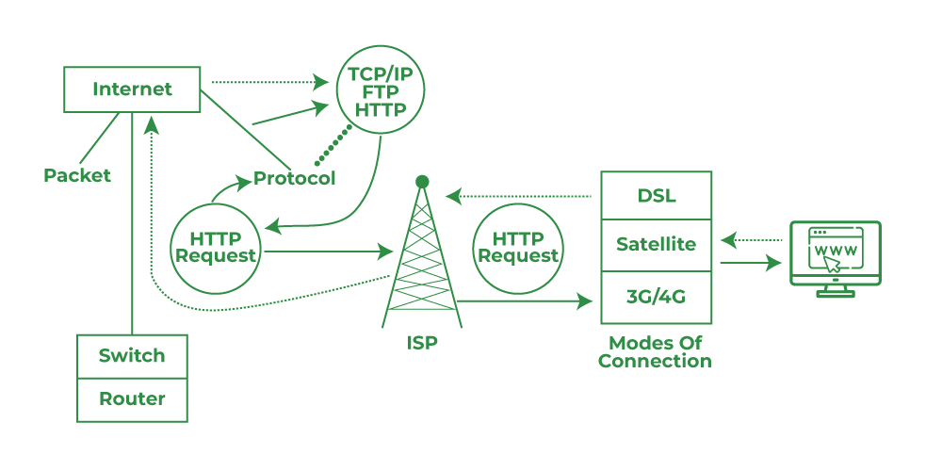
In Short
A user enters a URL into a browser (for example, Google.com. This request is passed to a domain name server.
The domain name server returns an IP address for the server that hosts the Website (for example, 68.178.157.132).
The browser requests the page from the Web server using the IP address specified by the domain name server.
The Web server returns the page to the IP address specified by the browser requesting the page. The page may also contain links to other files on the same server, such as images, which the browser will also request.
The browser collects all the information and displays to your computer in the form of Web page.

Slide 4
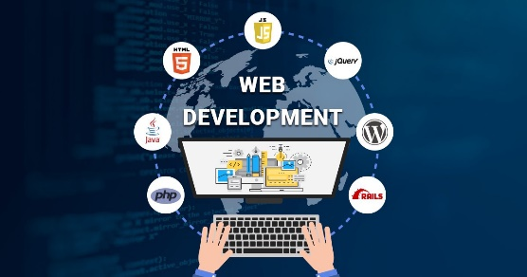
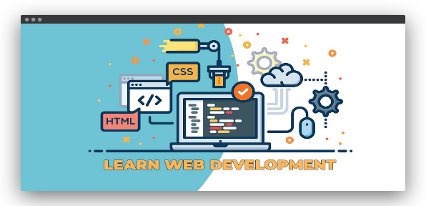

What do we need to be a web developer?
Traditionally, many Web Developers have started with higher education in software engineering, computer science, or related fields. However, it’s also possible to come from a completely different industry. In fact, a growing number of professionals are taking steps later in their careers to learn development by becoming self-taught or pursuing a diploma with a coding bootcamp,
To become a Web Developer, we should have an understanding of HTML, CSS, and JavaScript. Developing these fundamental web development skills will give us the foundation and logic for communicating with programming languages.
Although Web Developers need a mixture of education, soft skills, and technical skills, ultimately a core job responsibility is writing code, and that means that any Web Developer must have advanced programming skills with a thorough knowledge of any number of programming languages and libraries.

Slide 5
Operations evaluation
Project management
Complex problem-solving
Deductive reasoning
SEO strategy
Soft Skills
Coding and programming
Data analysis
User interface design
Database management
Testing and debugging
Hard Skills

Slide 6
Why did I choose to learn web development?
I’ll be working in the ever-developing digital industry, which is continuing to expand and evolve
I can be as creative as I wish - from websites to apps and emails, I can create incredible designs
I can work abroad - web development skills are highly transferable, ensuring I can work in almost any country I choose
I can work flexibly - if I choose to work as a freelance web developer, I can specify MY own hours, plus MY fee

